Slide 1
Predicting success with simplyx
Peter KindeR

Slide 2
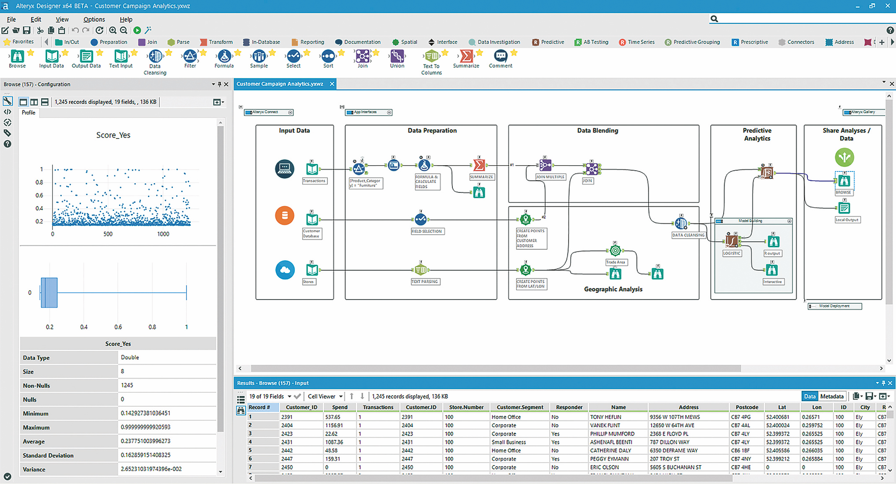
Alteryx: Data Prep & Analytics

Slide 3

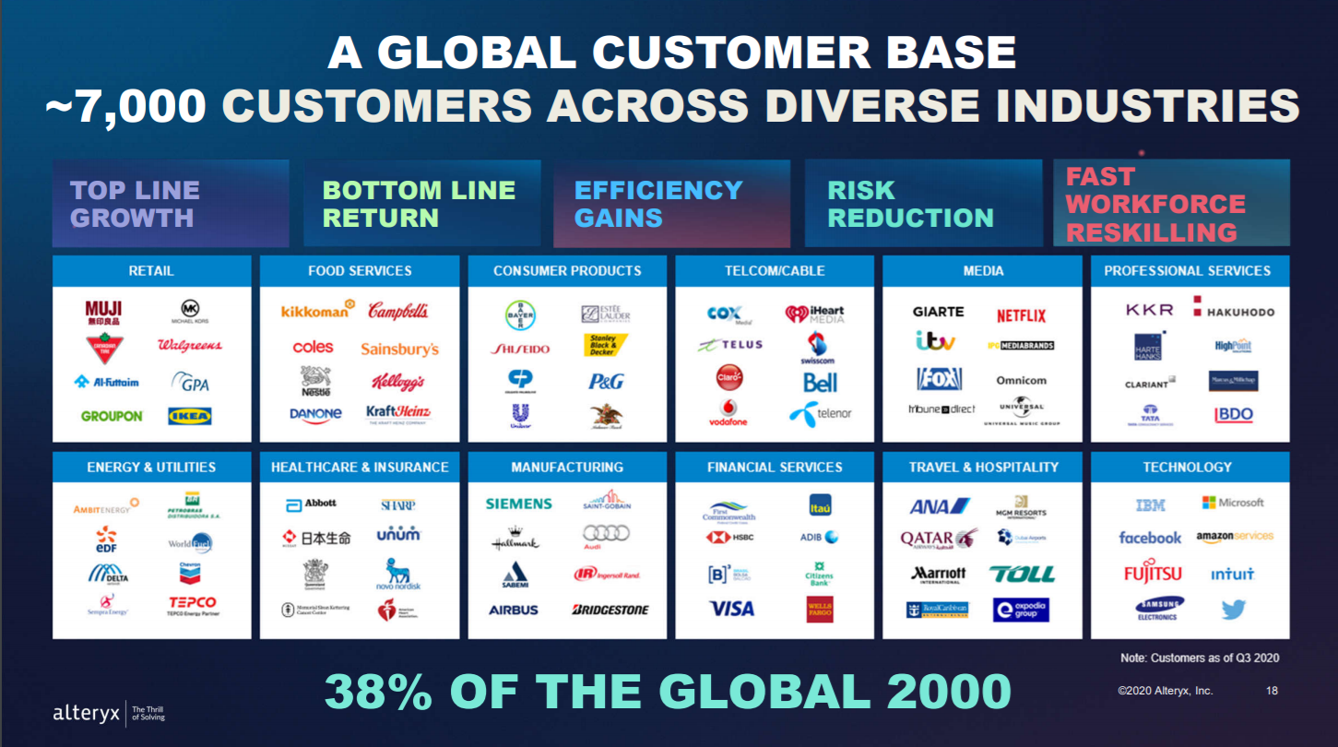

Slide 4
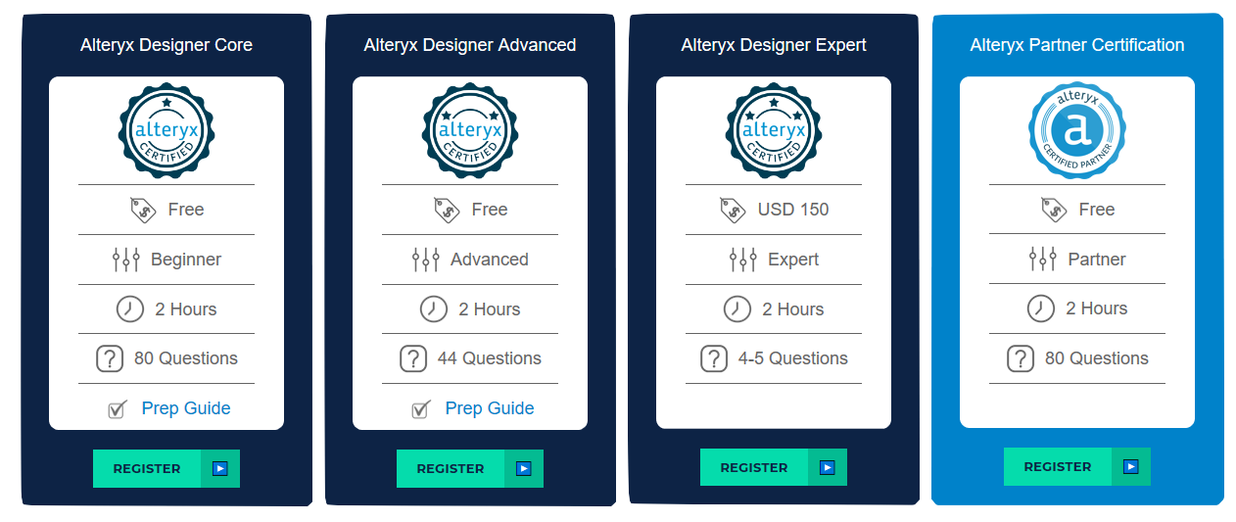
Alteryx certifications

Slide 5

Simplyx
DESIGNED TO FACILITATE ALTERYX DESIGNER CORE CERTIFICATION
COURSEWARE BUILT ATOP ALTERYX
DEMONSTRATED TO SIGNIFICANTLY BOOST PASS RATE

Slide 6
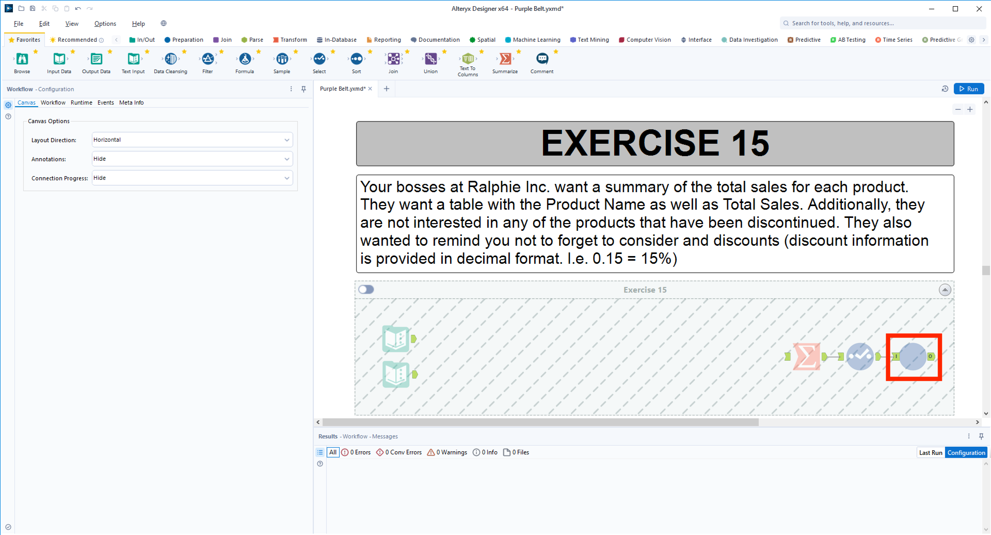
Simplyx Example

Slide 7


The problem
DEVELOP A MODEL TO PREDICT USER SCORES ON THE ALTERYX DESIGNER CORE CERTIFICATION WITH DATA OBTAINED FROM SIMPLYX USE

Slide 8

The DATA
100K+ USER LOG FILES
USER ID
PROBLEM #
BELT (SECTION) #
CORRECT SCHEMA (T/F)
CORRECT ANSWER (T/F)
TIMESTAMP
206 SIMPLYX USERS’ DESIGNER CORE CERTIFICATION SCORES

Slide 9

DATA PREP
6 BELT (SECTION) % SCORES
148 ONE HOT ENCODED VALUES
EACH PROBLEM SOLVED OR NOT
5 USAGE SUMMARY VALUES
TOTAL ATTEMPTS
TOTAL SESSIONS (1 HOUR SEPERATION)
AVG CORRECT PER SESSION
AVG ATTEMPTS PER SESSION
AVG SECONDS PER SESSION

Slide 10
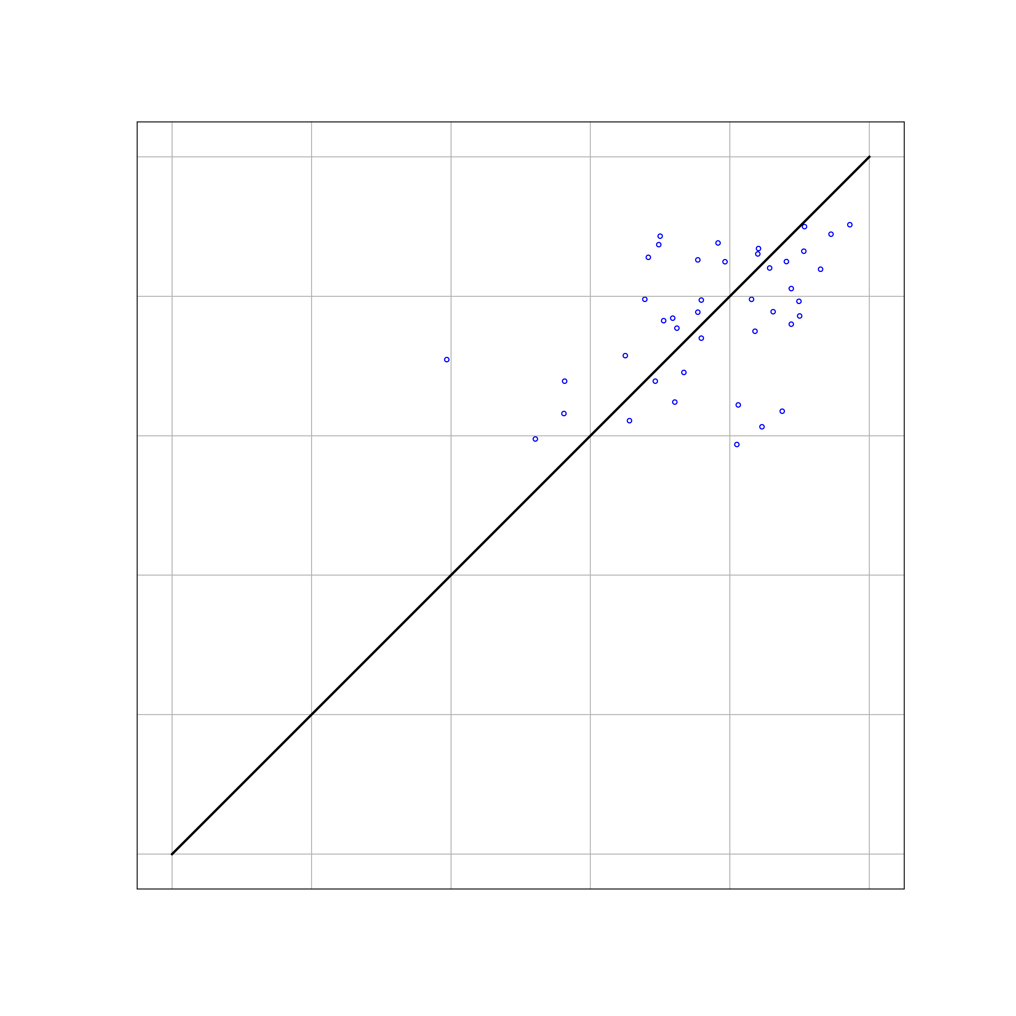
BAGGING
BOOTSTRAP WITH REPLACEMENT
GRID SEARCH FOR
# OF TREES
% OF SAMPLES
% OF FEATURES
MAE: 9.032
RMSE: 11.462

Slide 11

RANDOM FOREST
SPLIT ON SUBSET OF FEATURES IN EACH SPLIT
GRID SEARCH FOR
# OF TREES
DEPTH
% OF FEATURES
MAE: 7.750
RMSE: 10.454

Slide 12
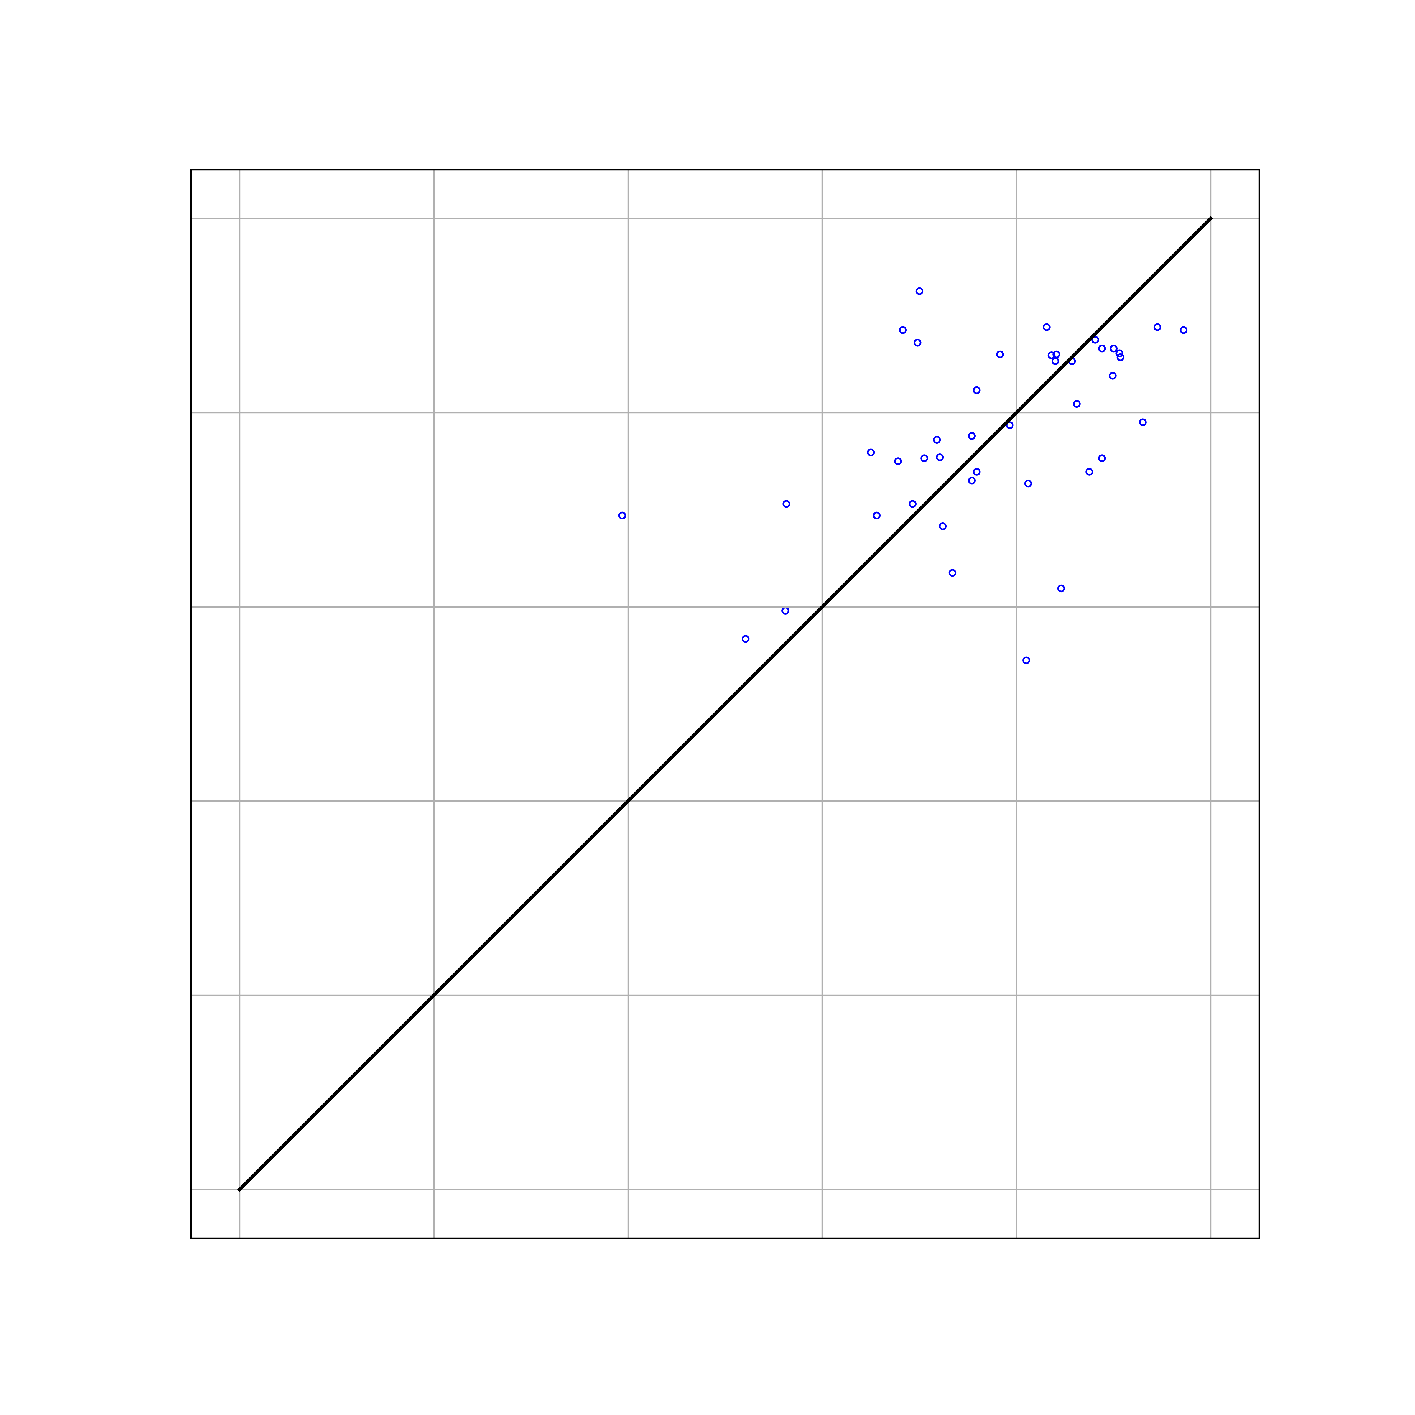
Boosting
LEARNS FROM PREVIOUS TREES
GRID SEARCH FOR
# OF TREES
LEARNING RATE
DEPTH
% OF FEATURES
MAE: 8.007
RMSE: 10.874

Slide 13

BART
RELATED TO ALL THREE PREVIOUS METHODS
GRID SEARCH FOR
# OF TREES
ALPHA
BETA
K
DEG OF FREEDOM
QUANTILE
MAE: 7.518
RMSE: 9.832

Slide 14
CONCLUSION
METHOD | RMSE | MAE
BART | 9.832 | 7.518
Random Forest | 10.454 | 7.750
Boosting | 10.874 | 8.007
Bagging | 11.462 | 9.032

